Slide 1
Emerging and Re emerging Arbovirus Infection in Bangladesh
Prof. Quazi Tarikul Islam
Professor of Medicine
Popular Medical College

Slide 3
Flaviviridae
A family of positive, single-stranded, enveloped RNA viruses.
Found in arthropods, (primarily ticks and mosquitoes), and can occasionally infect humans.

Slide 4
Classification
Flaviviridae
Group IV ((+)ssRNA)
Family: Flaviviridae
Genera:
Hepacivirus- HCV
Flavivirus- Yellow fever, Dengue, Zika, West nile
Pegivirus
Pestivirus

Slide 5
Flaviviruses are named from the yellow fever virus for the family;
the word flavus means "yellow" in Latin. The name yellow fever in turn originated from its propensity to cause jaundice.

Slide 7
There is extensive geographic distribution
and the diversity of the arthropod vectors or
vertebrates hosts associated with biological
transmission of these viruses.

Slide 9
Dengue and DHF is endemic in more than 100 countries in the WHO regions of
Africa,
Americas,
Eastern Mediterranean,
South-East Asia and
Western Pacific.
The South-East Asia and Western Pacific regions are the most seriously affected.

Slide 10
Yellow fever, which has epidemiological similarities to dengue, was under control in the mid-20th century, but is once again increasing.
Japanese encephalitis virus is numerically the most important cause of epidemic encephalitis; its geographical area is expanding despite the availability of vaccines.

Slide 11
Other mosquito-borne neurotropic flaviviruses with clinical and epidemiological similarities are found across the globe.
These include St Louis encephalitis virus, Murray Valley encephalitis virus, and West Nile virus.

Slide 12
In cooler northern climates ticks are more important vectors. Tick-borne encephalitis virus occurs across large parts of Eastern Europe and the Commonwealth of Independent states.
The tick-borne haemorrhagic flaviviruses, Omsk haemorrhagic fever and Kyasanur Forrest disease are localized in small areas.

Slide 14
Arboviruses
Flaviviruses are transmitted by Mosquitos
Yellow Fever, Dengue Fever, Japanese encephalitis, West Nile viruses, and Zika virus.
Flaviviruses are transmitted by ticks
Tick-borne Encephalitis (TBE), Kyasanur Forest Disease (KFD) and Alkhurma disease, and Omsk hemorrhagic fever.

Slide 15
Arboviruses
Chikungunya fever – Alphavirus (Togaviridae)

Slide 16
Evolution
The origin of these viruses- 9400 to 14,000 years ago.
World dengue strains (Old World and New )- 150 and 450 years ago
tick borne encephalitis strains diverged about 1087 years ago

Slide 17
Kunjin virus from West Nile virus -277 years ago.
The Japanese encephalitis in Africa 2000–3000 years ago.

Slide 18
Clinical triad of flavivirus
Many are spreading to new geographical areas and causing increased numbers of infections.
Traditionally, three clinical syndromes are recognized:
fever-arthralgia-rash,
viral haemorrhagic fever, and
neurological disease,
Though for some flaviviruses the disease pattern is changing.

Slide 19
How flaviviruses spread?
Flaviviruses are arboviruses, which means they are spread via infected arthropod vectors such as ticks and mosquitoes.
Some flaviviruses (such as West Nile) exist in a bird-mosquito cycle and infections in humans are typically incidental and a “dead-end” for the virus. This means it cannot be transmitted to a new mosquito.

Slide 20
However, Chikungunya, dengue and Zika exist predominantly in a human-mosquito cycle.
These viruses grow very well in the human body and therefore allow the re-infection of mosquitoes.

Slide 21
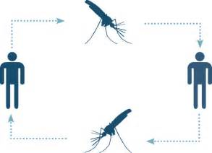
Bird-mosquito cycle
Human-mosquito cycle

Slide 22
BANGLADESH Dengue Zika Chikungunya

Slide 23
DENGUE

Slide 25
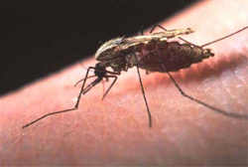
Dengue and dengue hemorrhagic fever: Key facts ( Global)
Dengue and DHF is endemic in more than 100 countries in the WHO regions of
Africa,
Americas,
Eastern Mediterranean,
South-East Asia and
Western Pacific.
The South-East Asia and Western Pacific regions are the most seriously affected.

Slide 26
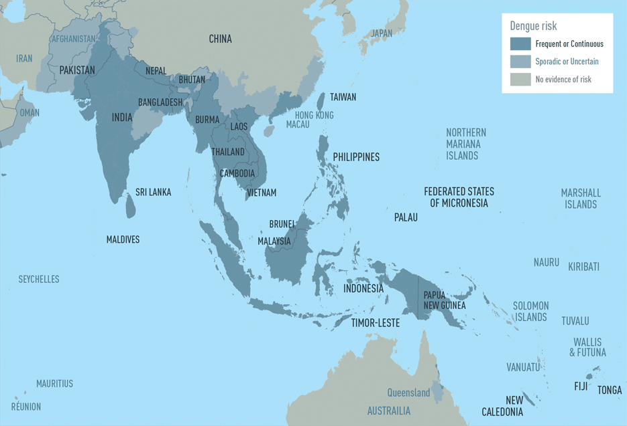

Slide 27
Dengue and dengue hemorrhagic fever: Key facts ( Global)
Some 2.5 billion people – two fifths of the world's population in tropical and subtropical countries – are at risk.
An estimated 50 million dengue infections occur worldwide annually.
An estimated 500 000 people with DHF require hospitalization each year and about 2.5% of those affected die.

Slide 28
Dengue and dengue hemorrhagic fever: Key facts
Epidemics of dengue are increasing in frequency. Aedes (Stegomyia) aegypti is the primary epidemic vector.
It is primarily an urban disease, but dengue and DHF are now spreading to rural areas worldwide.

Slide 29
Climate change and its impact on dengue disease burden
Global warming - A 2.0 °C–4.5 °C rise in average global temperatures by the year 2100.
With a 2 °C increase in temperature the incubation period of DENV will be shortened.
Mosquitoes will bite more frequently because of dehydration.

Slide 30
In Bangladesh first diagnosed case of Dengue was in 1999.
It re-emerged in Bangladesh in 2000 after an earlier outbreak as Dhaka Fever in 1960s.
According to the CDC, DGHS, in Dhaka city the total number of cases up to September is 1507 in 2017.

Slide 32
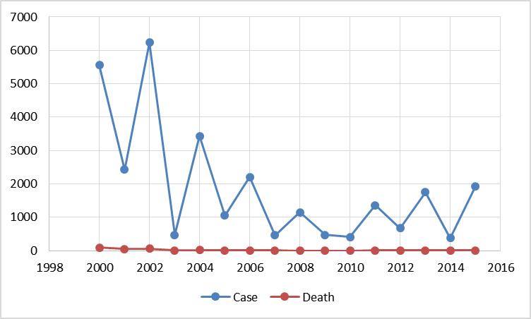

Slide 34
DENGUE

Slide 35
Structure
There are four virus serotypes, which are designated as DENV-1, DENV-2, DENV-3 and DENV-4.
Infection with any one serotype confers lifelong immunity to that virus serotype.

Slide 36
Dengue virus infection
10,000
Asymptomatic Symptomatic
Viral syndrome Dengue fever DHF
9,000
1,000
500
400
100
Plasma leakage
Expanded dengue syndrome (Uncommon)
Prolonged shock: liver failure,
renal failure,…Encephalopathy…
Co-morbidities
3. Co-infections
4. True dengue infection - encephalitis
DHF
DSS
1-2

Slide 37
Natural course of DHF
Day 1 2 3 4 5 6 7 8 9
Fever
Shock
Pleural effusion,
Ascites
Hematocrit
Plasma leakage
Stop leakage
Reabsorption
Fluid overload
IV fluid: NSS, DAR, DLR
Colloid: 10%Dextran, 10%Haes-steril
M+5% Deficit
(= 4,600 ml in adult)
WBC
Tourniquet Test
WBC 6,000-9,000 ≤5,000
Platelet count ≤100,000 ≤ 50,000
Hct 35 38 45 (rising 20%)
Albumin ≤3.5 gm%
Cholesterol ≤100 mg%

Slide 38
Clinical features of dengue infection
Dengue
Systemic
Bleeding
diathesis
Vascular
permeability
Hepatic
Other
(rare)
Fever
Malaise
Headache
Muscle/joint
pain
Rash
Fatigue
Thrombocytopenia
Tourniquet test
Petechiae
Coagulopathy
Gross bleeding
Plasma leakage
Hemoconcentration
Pleural effusion
Ascites
Elevated
transaminases
Encephalopathy
Liver failure
Shock

Slide 39
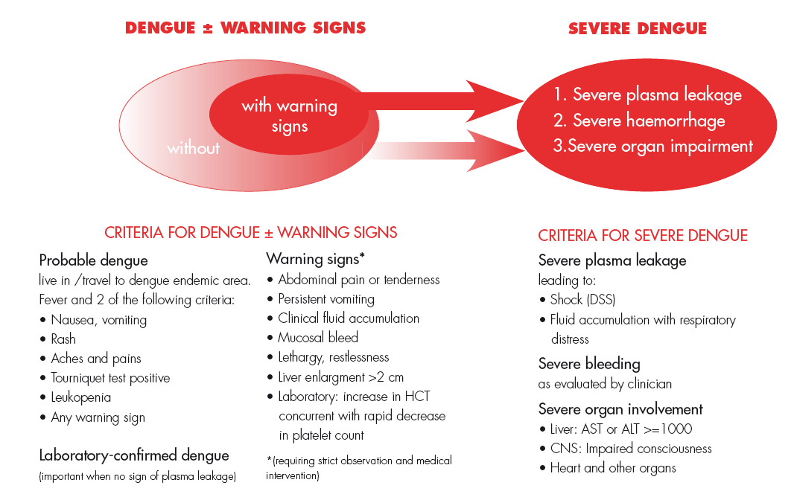

Slide 40
Expanded dengue syndrome (Unusual or atypical manifestations)
In recent years there have been increasing reports of DF and DHF with unusual manifestations.
These include: neurological, hepatic, renal and other isolated organ involvement.

Slide 41
ZIKA

Slide 42
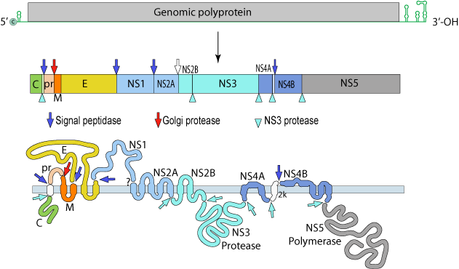
ZIKA VIRUS
Single stranded RNA virus

Slide 43
In April 1947 Zika virus was first isolated from a rhesus monkey found in Uganda’s Zika forest

Slide 44
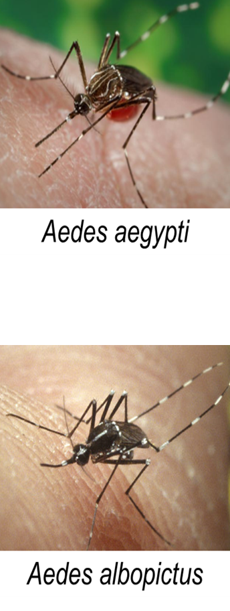
Zika virus (Zika)
Primarily transmitted through the bite of an infected Aedes species mosquito (Ae. aegypti and Ae. albopictus)
Closely related to dengue, yellow fever, Japanese encephalitis, and West Nile viruses

Slide 45
Zika-Affected Areas
Prior to 2015, Zika virus outbreaks occurred in Africa, Southeast Asia, & Pacific Islands.
February 1, 2016: World Health Organization declares Zika an International Public Health Emergency

Slide 47
Zika virus clinical disease course and outcomes
Clinical illness is usually mild.
Symptoms last several days to a week.
Severe disease requiring hospitalization is uncommon.
Fatalities are rare.
Guillain-Barré syndrome (GBS) reported in patients following suspected Zika virus infection.

Slide 48
Incubation and viremia
Some infected pregnant women can have evidence of Zika virus in their blood longer than expected.
Virus remains in semen longer than in blood.

Slide 49
Symptoms
Many infections asymptomatic.
Most common symptoms
Acute onset of fever
Maculopapular rash
Joint pain
Conjunctivitis
Other symptoms include muscle pain and headache.

Slide 51
CHIKUNGUNYA

Slide 52
CHIKUNGUNYA
CHIKV Fever
Buggy Creek virus infection
Knuckle fever
Me Tri virus infection
Semliki Forest virus infection

Slide 53
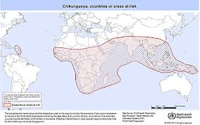
First described during an outbreak in southern Tanzania in 1952.
It is an RNA virus that belongs to the alphavirus genus of the family Togaviridae.
Chikungunya has been identified in over 60 countries in Asia, Africa, Europe and the Americas.

Slide 54
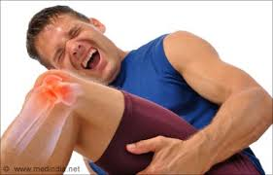
“Chikungunya” derives from a word in the Kimakonde language, meaning “to become contorted”, and describes the stooped appearance of sufferers with joint pain (arthralgia).

Slide 55
MODE OF TRANSMISSION
By Infected Female mosquitoes.
They bite usually during day time.

Slide 56
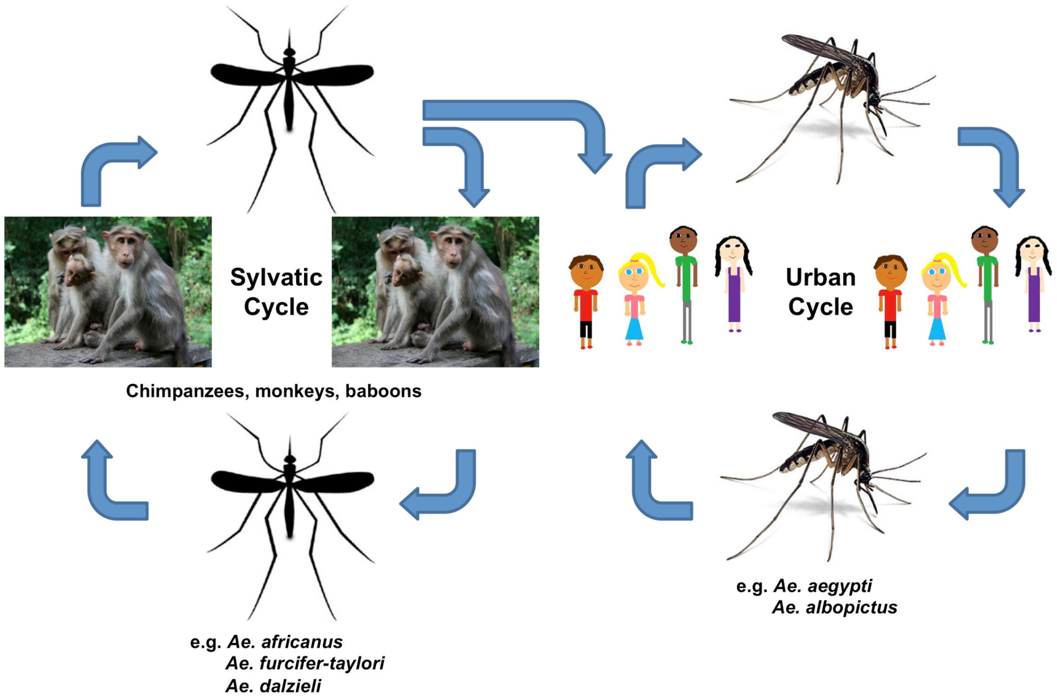

Slide 57
Sign and Symptoms (phases):
Clinical presentation of Chikungunya usually follows 3 phases:
Acute Phase (<3 weeks)
abrupt onset of signs and symptoms.
Subacute phase(>3 weeks to 3 months)
generalized weakness, polyathralgia,joint stiffness.
Chronic phase(>3 months)
Athritis, recurrent joint swelling after each episode of any
fever, recurrent joint pain.

Slide 58
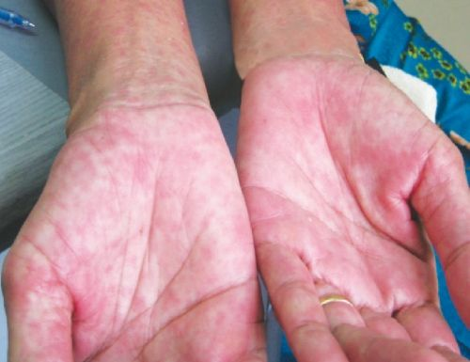
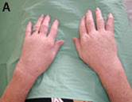
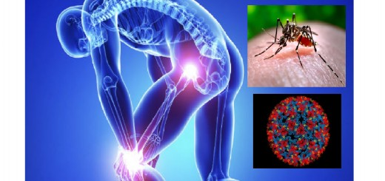
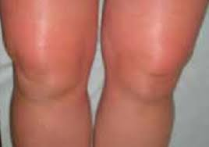

Slide 59
Rare But Serious Complications:
Acute encephalopathy
Dementia
Retinitis
Uveitis
Myocarditis
Intestinal Hemorrhage

Slide 60
High Risk Group:
Geriatric age group and paediatric age group.
Any co morbid conditions (DM, HTN, CVD, COPD, Hypothyroidism)
Pregnancy
Any Co-Infection(Dengue,TB,Enteric Fever,HIV,Malaria)

Slide 61
Investigations:
A definitive lab diagnosis can be accomplished through three main lab test:
Virus Isolation
RT-PCR
Serological test (IgM,IgG,MAC-ELISA)

Slide 63
Diagnostic challenges in Chikungunya

Slide 64
Chikungunya in Bangladesh
No evidence of chikungunya virus in Bangladesh before 2008
First identified outbreak of chikungunya in Bangladesh,2008.
2008 – Paba , Rajshahi
2009 – Shathiya, Pabna
2011 – Dohar , Dhaka
2012 - Palpara, Tangail
2013 - Chittagong ( case series)

Slide 65
Outbreak –Epidemic of CHIKUNGUNYA
occurred in early 2017. Causes may be
Early rain
Lack of preparedness and
Health education

Slide 66
At least 1.8 million people are feared to be infected with Chikungunya in the capital this year. One in 10 people in the city are at risk of the mosquito-borne fever, says a study.
July 10, 2017, The Daily Prothom Alo

Slide 68
Number of cases of probable Chikungunya and post Chikungunya arthropathy in different Medical College Hospitals

Slide 69
Clinical features: Zika virus compared to dengue and chikungunya

Slide 70
The following 248 cases have been documented in CRF of a prepared protocol from April to August 2017, during the outbreak of Chikungunya at Popular Medical College Hospital, Dhaka.
‘Recent Clinical Experiences with Chikungunya’, Islam Quazi Tarikul, Majumder M, Basit A, Bangladesh J Medicine 2017; 28 : 104-106.

Slide 87
Take Home Massage
The factors associated with the emergence and re-emergence of arboviral diseases are complex.
Collaboration among academia and public health communities is critical in efforts to contain the menace of arboviral diseases emergence/ resurgence.

Slide 88
The research priorities in this field should encompass:
Understanding environmental factors which facilitate emergence, maintenance and transmission of these diseases
Studying the evolution of pathogenic infectious agents resulting in changes in infectivity, virulence, transmissibility and adaptations,
Host factors influencing emergence of new infection and their transmission;

Slide 89
Development of tools for diagnosis, management, control and prophylaxis;
Training and infrastructure for responding to emerging diseases; and
Information sharing on emerging infections and development of research-based evidence to influence policy modifications with respect to the public health improvement.

Slide 90
THANK YOU

